Slide 1

OpenTripPlanner (OTP)
Complex Social Systems, Lab 1
Summer semester 2023-2024
Anastasia Psarou

Slide 2
What is OpenTripPlanner (OTP)?
OpenTripPlanner (OTP) is an open source multi-modal trip planner, focusing on travel by scheduled public transportation in combination with bicycling, walking, and mobility services including bike share and ride hailing.

Slide 3

How does OTP work?
Before OTP plans a trip it needs two datasets:
GTFS (General Transit Feed Specification) – Public Transit Data
OSM (Open Street Map) data

Slide 4
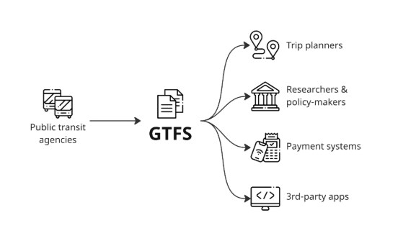
What is GTFS?
It is a standardized data format that provides a structure for public transit agencies to describe the details of their services such as schedules, stops, fares etc.

Slide 5
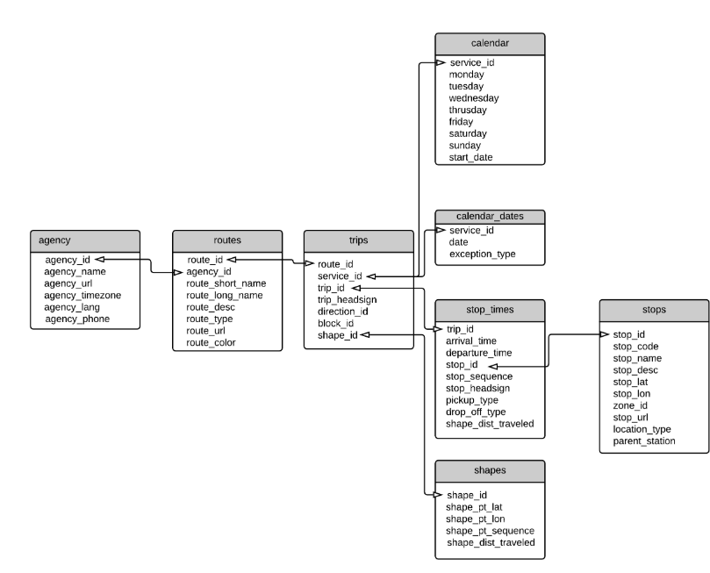
What is GTFS?
Files in the GTFS Schedule format are a compressed .zip file that contains a set of tables, saved in separate .txt format, describing some aspects of the public transport network (stops/stations location, trip frequency, itineraries paths, etc.)

Slide 6
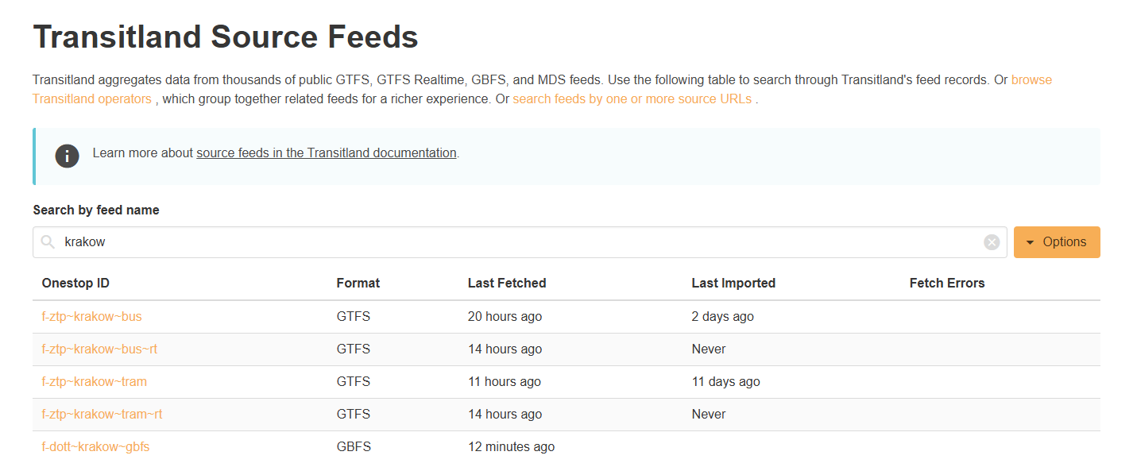
Where can you find GTFS files?
GTFS files can be accessed from transit.land after creating an account.

Slide 7
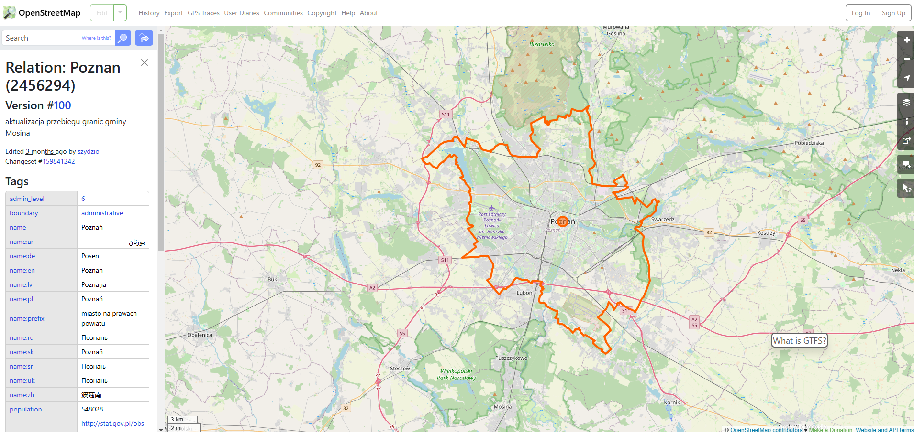
What is OpenStreetMap?
OpenStreetMap is a free, editable map of the whole world. It includes data about roads, buildings, addresses, shops and businesses, points of interest, railways, trails, transit, land use and natural features, and much more.

Slide 8
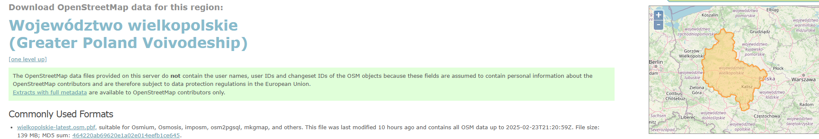
How to get OpenStreetMap data?
Use Geofabrik, that extract, select, and process free geodata.
The problem with Geofabrik is that it extracts the whole voivodeship and then we need to process it more to extract a specific city.

Slide 9

Let’s create an OTP server and plan our trips
Visit the github repository that contains the details of the course: https://github.com/RafalKucharskiPK/ComplexSocialSystemsCourse/tree/f68bca5ab4d94ea3f1dfe9fe721ae408806d7748 .
Open the folder labs/lab1

Slide 10
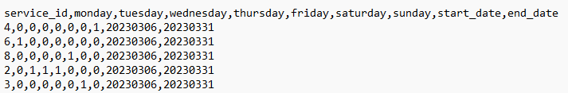
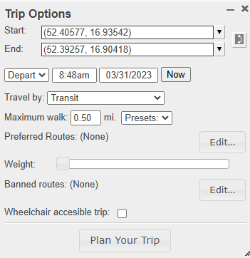
How to plan a trip using OpenTripPlanner?
Visit the http://localhost:8080/ while running the OTP server.
Choose one of the dates from the calendar.txt file included in the gtfs data.
Choose start and end points and plan your trip.

Slide 11

How to plan a trip using OpenTripPlanner?
Visit the http://localhost:8080/ while running the OTP server.
Choose one of the dates from the calendar.txt file included in the gtfs data.
Choose start and end points and plan your trip.

Slide 12
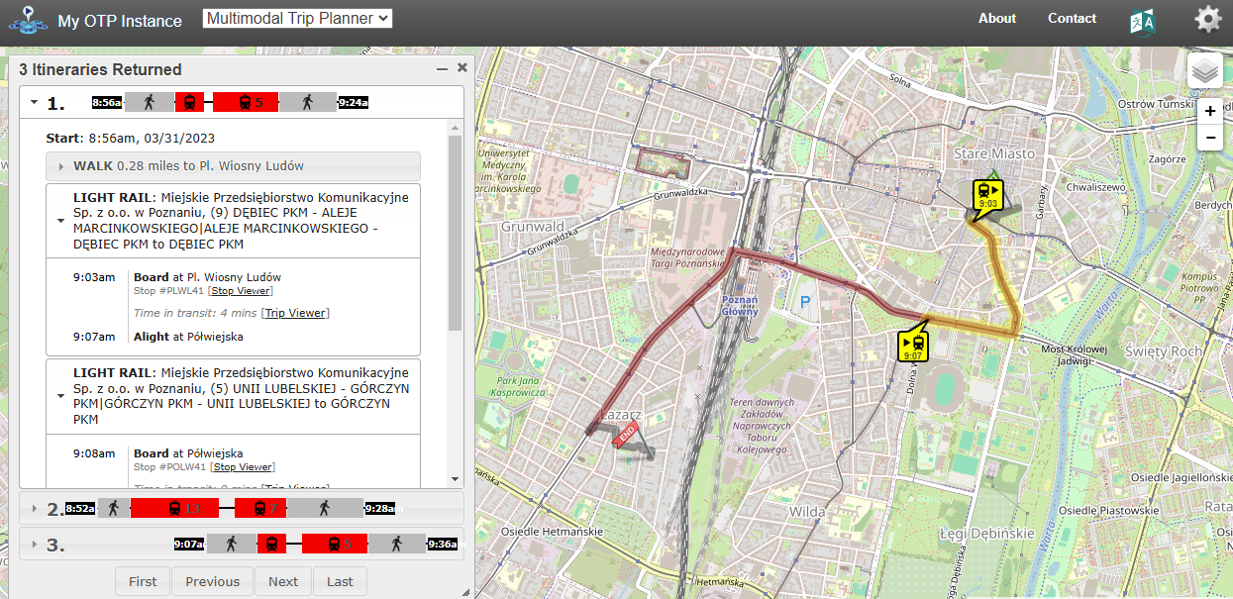

Slide 13
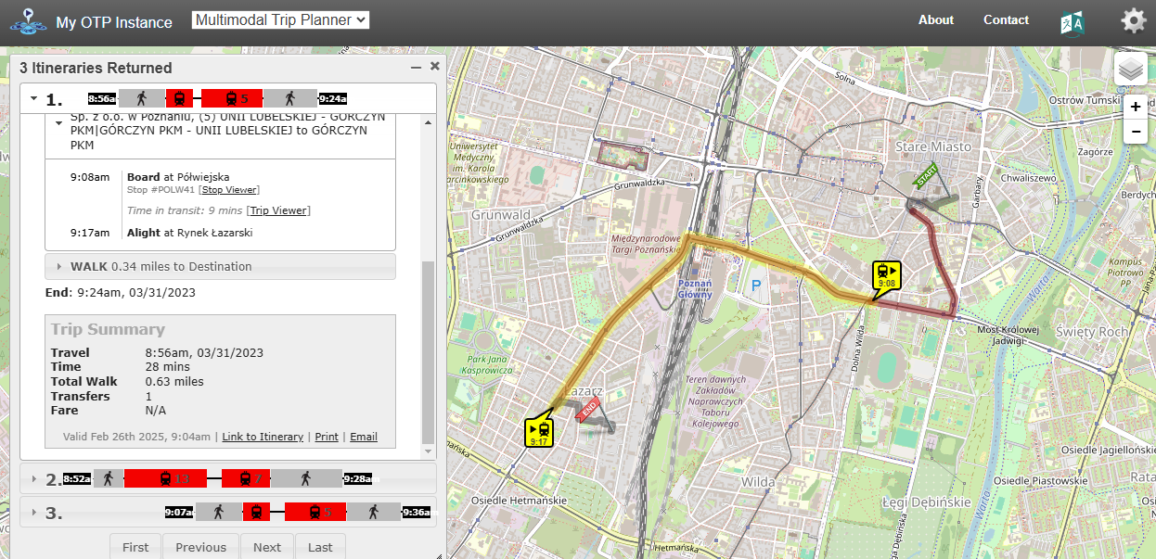

Slide 14
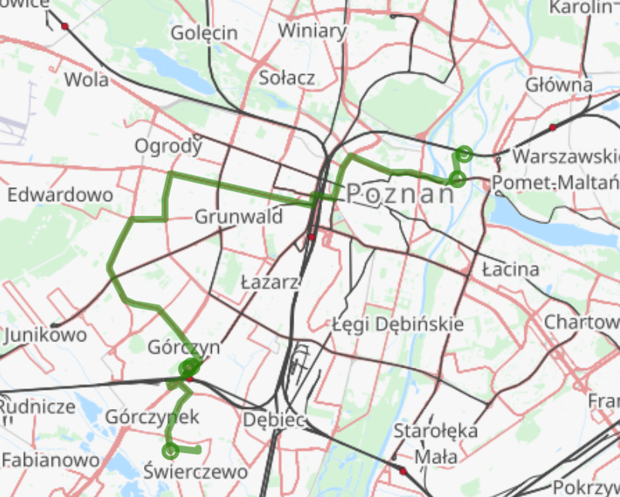
How to plan a trip using OpenTripPlanner?
Create a query that contains:
Origin(16.9498,52.4140)
Destination(16.8841,52.3697)
Time
Date
Mode of transport
Best one is 72min (1415m walk, 1 transfer(s), wait time 3.07min)
LEG | MODE | DIST | TIME
1 | WALK | 776 | 635
2 | BUS | 10522 | 2520
3 | WALK | 73 | 58
4 | BUS | 2509 | 480
5 | WALK | 565 | 450

